Slide 1
Linear Regression and k-NN
(Part A)
Theory

Slide 2

Contents
Understadning and Implementing Representative Machine Learning Techniques
  Univariate Linear Regression
  Multivariate Linear Regression
  Nearest Neighbor Models
  Implementation and Experiments
Next time...
In this lecture, we will study representative machine learning techniques: Linear Regression and Nearest Neighbor Model.

Slide 3
INTRO
Machine Learning (기계 학습, 머신 러닝)
  A field of technology that develops algorithms and statistical models used by computer systems to perform pattern recognition and inference, and to perform tasks on their own without explicit instructions
  Computer systems use machine learning algorithms to process large amounts of data and identify patterns.
  => Through this, accurate results can be predicted.
  In other words, Machine Learning is a technology that recognizes patterns autonomously through learning and performs accurate prediction through inference.
Training
Training
Data
Prediction
New Data
Prediction Model
Prediction Model
https://aws.amazon.com/ko/what-is/machine-learning/

Slide 4
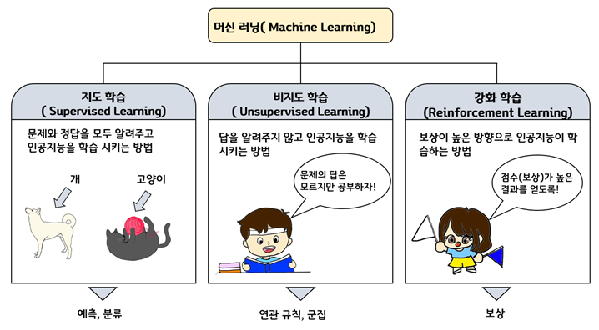
INTRO
Classification of Machine Learning
  Machine learning is classified into Supervised Learning, Unsupervised Learning, and Reinforcement Learning.
    Supervised Learning: A method of training a machine to find patterns between data and answers using multiple (data, answers) as input, so that it can correctly predict the answer when new data is given.
    Unsupervised Learning: A method of training a machine to find patterns and correlations between data using multiple (data) as input.
    Reinforcement Learning: A method of training a machine using continuous (actions, rewards) as input, so that it autonomously finds the actions that lead to high rewards.
http://ai4school.org/?page_id=2617

Slide 5
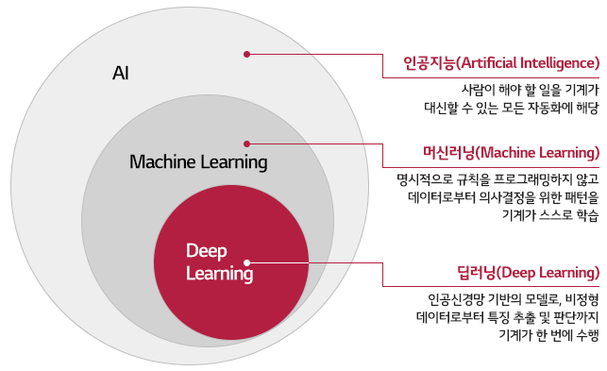
INTRO
AI(인공지능), ML(기계학습), DL(딥러닝) Relationships
Pertains to all automation where a machine can perform tasks that a human should do.
The machine autonomously learns patterns for decision-making from data without explicit programming of rules.
A model based on artificial neural networks, where the machine performs the entire process—from feature extraction to judgment—from unstructured data in a single step.

Slide 6
Univariate Linear Regression

Slide 7
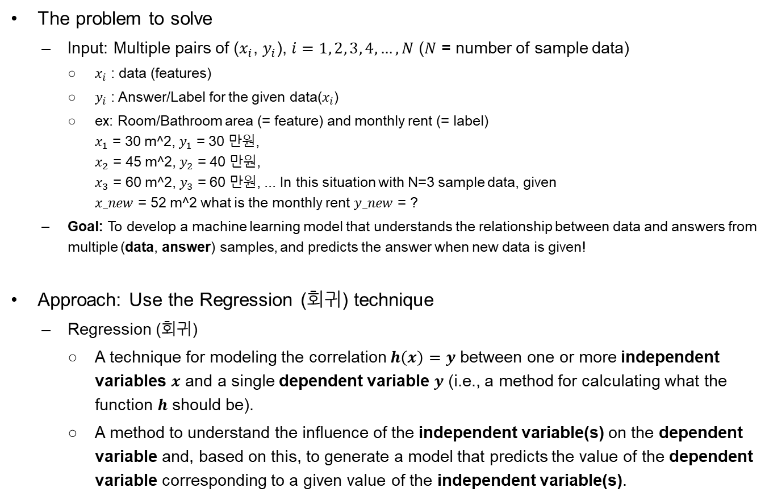
Regression
The problem to solve
  Input: Multiple pairs of ($x_{i}$, $y_{i}$), $i=1, 2, 3, 4,…, N$ ($N$ = number of sample data)
    $x_{i}$ : data (features)
    $y_{i}$ : Answer/Label for the given data($x_{i}$)
    ex: Room/Bathroom area (= feature) and monthly rent (= label)
    $x_{1}$ = 30 m^2, $y_{1}$ = 30 만원,
    $x_{2}$ = 45 m^2, $y_{2}$ = 40 만원,
    $x_{3}$ = 60 m^2, $y_{3}$ = 60 만원, ... In this situation with N=3 sample data, given
    $x_new$ = 52 m^2 what is the monthly rent $y_new$ = ?
  Goal: To develop a machine learning model that understands the relationship between data and answers from multiple (data, answer) samples, and predicts the answer when new data is given!
Approach: Use the Regression (회귀) technique
  Regression (회귀)
    A technique for modeling the correlation $h\left(x\right)=y$ between one or more independent variables $x$ and a single dependent variable $y$ (i.e., a method for calculating what the function $h$ should be).
    A method to understand the influence of the independent variable(s) on the dependent variable and, based on this, to generate a model that predicts the value of the dependent variable corresponding to a given value of the independent variable(s).

Slide 8
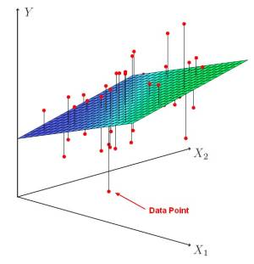
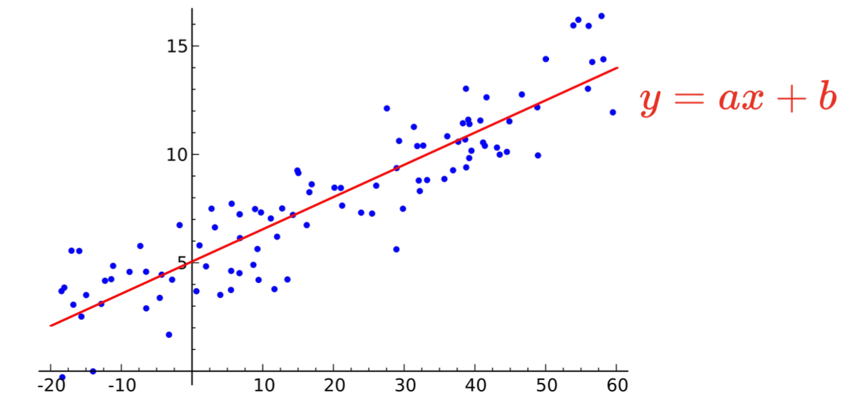
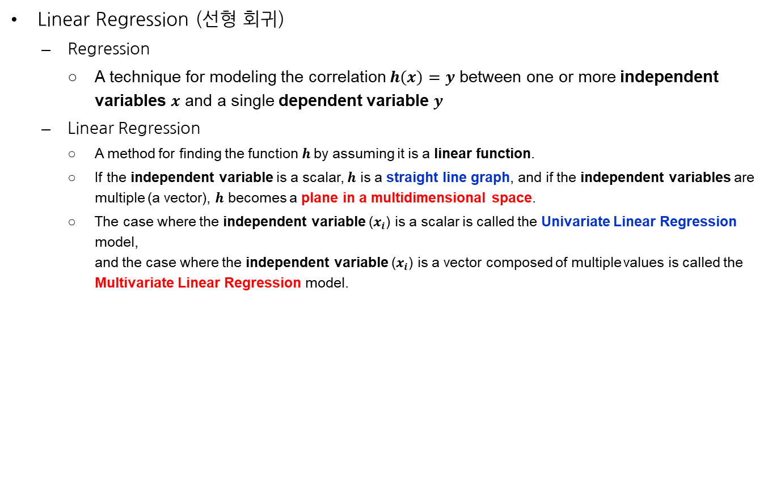
Linear Regression
Linear Regression (선형 회귀)
  Regression
    A technique for modeling the correlation $h\left(x\right)=y$ between one or more independent variables $x$ and a single dependent variable $y$
  Linear Regression
    A method for finding the function $h$by assuming it is a linear function.
    If the independent variable is a scalar, $h$ is a straight line graph, and if the independent variables are multiple (a vector), $h$ becomes a plane in a multidimensional space.
    The case where the independent variable ($x_{i}$) is a scalar is called the Univariate Linear Regression model,
    and the case where the independent variable ($x_{i}$) is a vector composed of multiple values is called the Multivariate Linear Regression model.
https://datacadamia.com/data_mining/multiple_regression

Slide 9


Univariate Linear Regression
ULR
  A technique for linearly (=straight-line graph) modeling the correlation between a scalar independent variable $x$and a dependent variable $y = h\left(x\right).$
  Approach
    Assume an arbitrary straight-line graph function $h_{w}\left(x\right)=w_{1}x+w_{0}$ ($w_{1}$: slope/gradient, $w_{0}$: $y$-intercept).
    Adjust the values of $w_{1}$ and $w_{0}$ to make the function $h_{w}\left(x\right)$ represent/describe the entire dataset as accurately as possible.
    But, what exactly does it mean to "most accurately" represent...?
Inaccurate Model Function
Optimal Model Function
$$y=h_{w}\left(x\right)=w_{1}x+w_{0}$$
Inaccurate Model Function

Slide 10
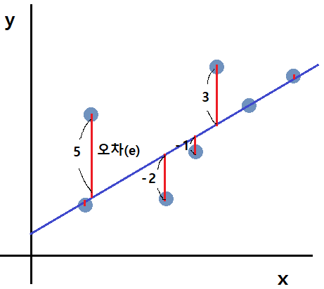
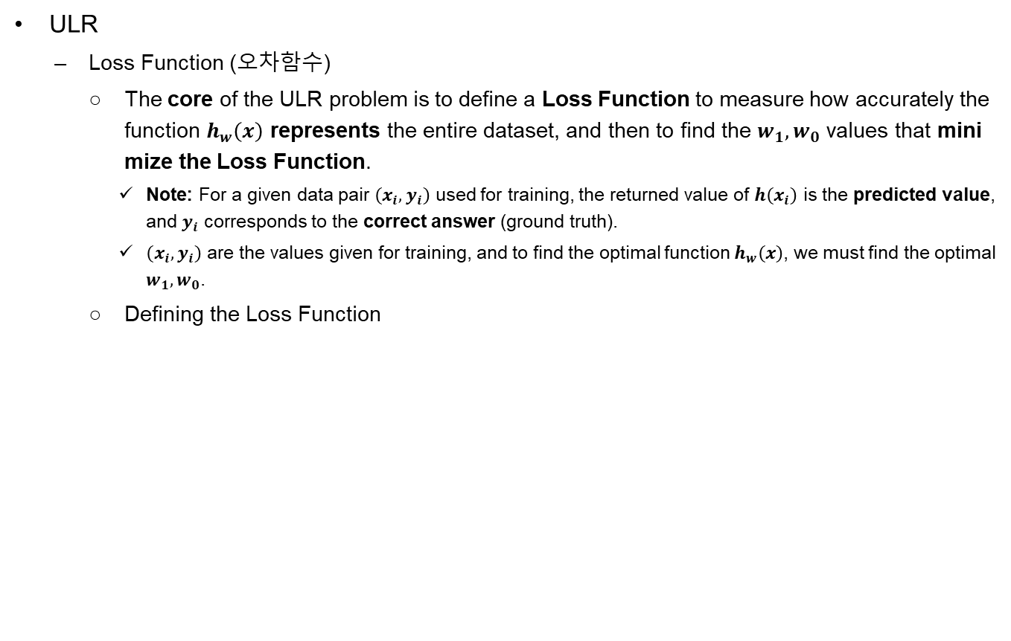
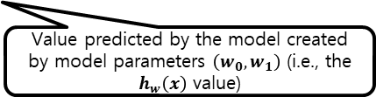
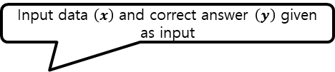
Univariate Linear Regression
ULR
  Loss Function (오차함수)
    The core of the ULR problem is to define a Loss Function to measure how accurately the function $h_{w}\left(x\right)$ represents the entire dataset, and then to find the $w_{1},w_{0}$ values that minimize the Loss Function.
      Note: For a given data pair $\left(x_{i},y_{i}\right)$ used for training, the returned value of $h\left(x_{i}\right)$ is the predicted value, and $y_{i}$ corresponds to the correct answer (ground truth).
      $\left(x_{i},y_{i}\right)$ are the values given for training, and to find the optimal function $h_{w}\left(x\right)$, we must find the optimal $w_{1},w_{0}$.
    Defining the Loss Function
Input data $\left(x\right)$ and correct answer $\left(y\right)$ given as input
Value predicted by the model created by model parameters $\left(w_{0},w_{1}\right)$ (i.e., the $h_{w}\left(x\right)$ value)

Slide 11

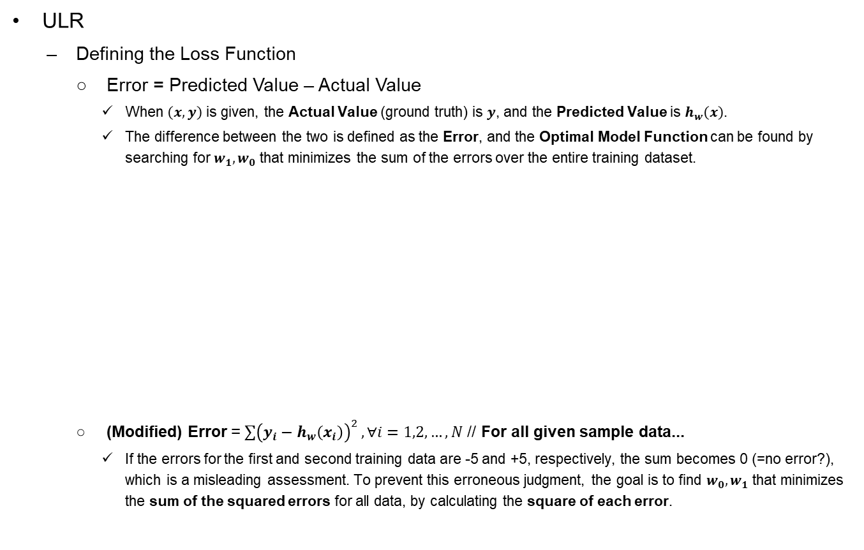
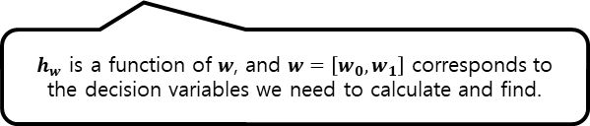

Univariate Linear Regression
ULR
  Defining the Loss Function
    Error = Predicted Value – Actual Value
      When $\left(x,y\right)$ is given, the Actual Value (ground truth) is $y$, and the Predicted Value is $h_{w}\left(x\right)$.
      The difference between the two is defined as the Error, and the Optimal Model Function can be found by searching for $w_{1},w_{0}$ that minimizes the sum of the errors over the entire training dataset.
    (Modified) Error = $\sum{{\left(y_{i}−h_{w}\left(x_{i}\right)\right)}^{2}},∀i=1,2,…,N$ // For all given sample data...
      If the errors for the first and second training data are -5 and +5, respectively, the sum becomes 0 (=no error?), which is a misleading assessment. To prevent this erroneous judgment, the goal is to find $w_{0},w_{1}$ that minimizes the sum of the squared errors for all data, by calculating the square of each error.
Model: $h_{w}\left(x\right)=w_{0}+w_{1}x$
(x₃,y₃)
$h_{w}$ is a function of $w$, and $w=\left[w_{0},w_{1}\right]$ corresponds to the decision variables we need to calculate and find.
(x₁,y₁)
[Error] ${err}_{1}=h_{θ}\left(x_{2}\right)−y_{2}=\left(θ_{0}+θ_{1}x_{2}\right)−y_{2}$
(x₂,y₂)
Given values (Training Data)

Slide 12
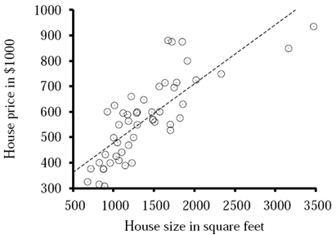
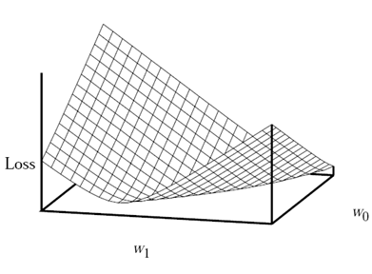
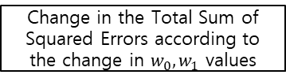

Univariate Linear Regression
The task of finding h_{w} that best fits the data
h_{w}(x) = w₁x + w₀
Need to find the values of the weights [w₀, w₁] (= w) that minimize the sum of squared error over all the training examples:
N : The number of samples $(x_{i}, y_{i})$ for training
Change in the Total Sum of Squared Errors according to the change in $w_{0}, w_{1}$ values
Example of the Optimal Model Function

Slide 13
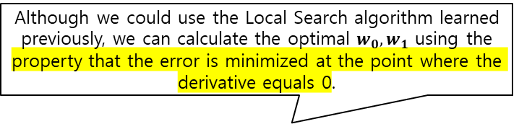
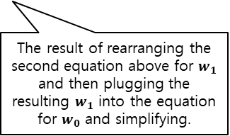
Univariate Linear Regression
To minimize the sum
These equations have a unique, closed-form solution:
The result of rearranging the second equation above for $w_{1}$ and then plugging the resulting $w_{1}$ into the equation for $w_{0}$ and simplifying.
Although we could use the Local Search algorithm learned previously, we can calculate the optimal $w_{0},w_{1}$ using the property that the error is minimized at the point where the derivative equals 0.

Slide 14
Multivariate Linear Regression

Slide 15
Multivariate Linear Regression
MLR
  Until now, we have looked at Univariate LR where the independent variable is only one (a scalar).
  What if there are multiple independent variables?
    ex: {room: 3개, Bathroom: 2개} = 80만원 ...
  We extend Univariate LR to use Multivariate LR! (The operating principle is the same)

Slide 16
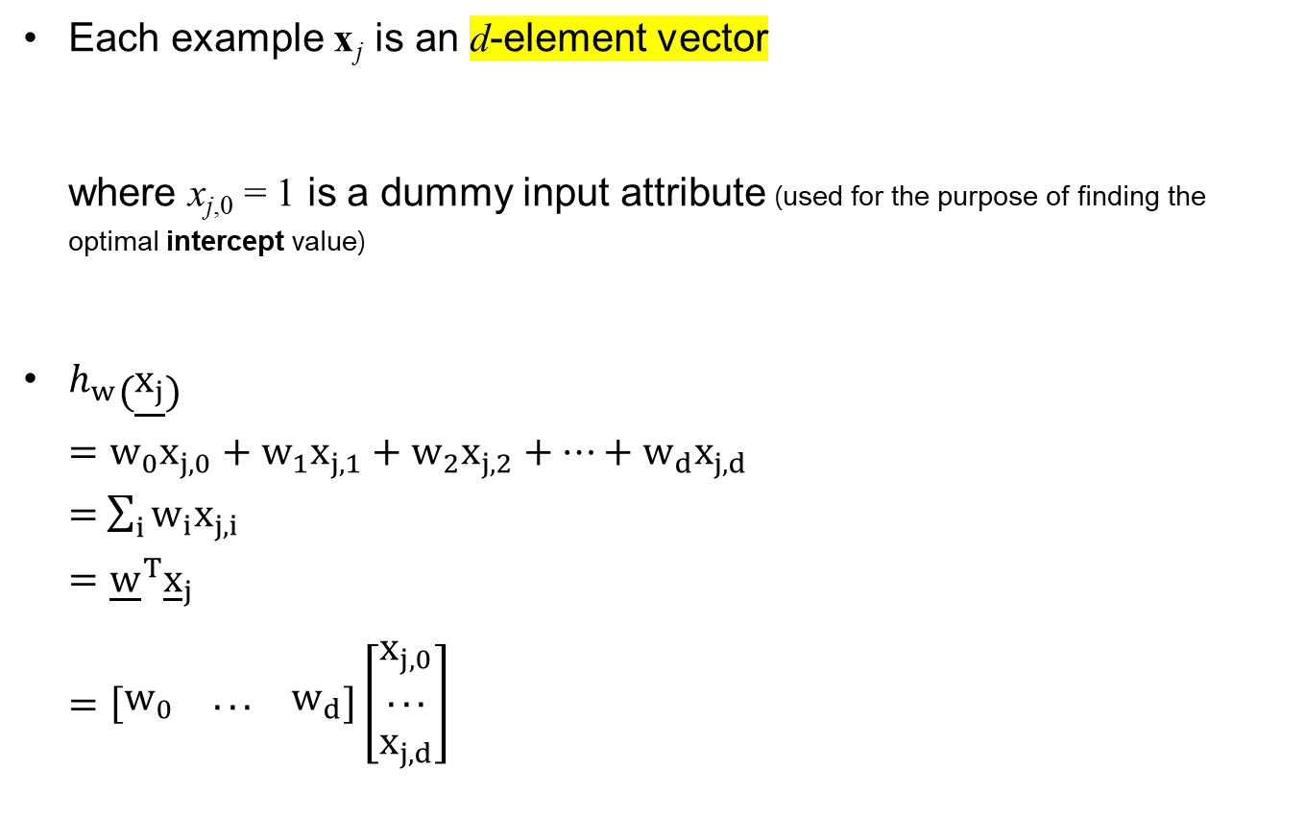
Multivariate Linear Regression
Each example x _{j} is an d-element vector
where x_{j,0} = 1 is a dummy input attribute (used for the purpose of finding the optimal intercept value)
$h_{w}\left(\underline{x_{j}}\right)$
$=w_{0}x_{j,0}+w_{1}x_{j,1}+w_{2}x_{j,2}+…+w_{d}x_{j,d}$
= $\sum_{i}{w_{i}x_{j,i}}$
$={\underline{w}}^{T}{\underline{x}}_{j}$
$=\left[\begin{matrix}w_{0} & ... & w_{d}\end{matrix}\right]\left[\begin{matrix}x_{j,0} \\ ... \\ x_{j,d}\end{matrix}\right]$

Slide 17
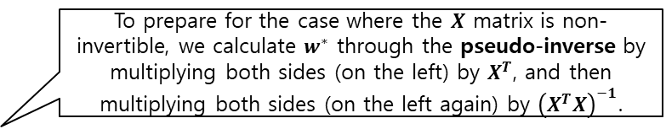
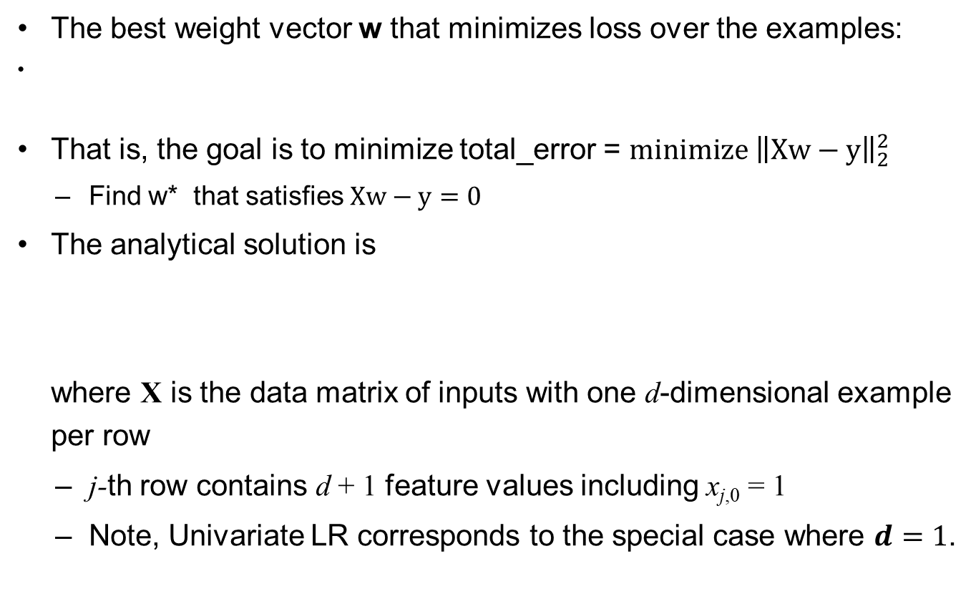
Multivariate Linear Regression
The best weight vector w that minimizes loss over the examples:
That is, the goal is to minimize total_error = $\text{min}\text{imize}⁡ {\left\|Xw−y\right\|}_{2}^{2}$
  Find w* that satisfies $Xw−y=0$
The analytical solution is
where X is the data matrix of inputs with one d-dimensional example per row
  j-th row contains d + 1 feature values including x_{j,0} = 1
  Note, Univariate LR corresponds to the special case where $d=1$.
To prepare for the case where the $X$ matrix is non-invertible, we calculate $w^{∗}$ through the pseudo-inverse by multiplying both sides (on the left) by $X^{T}$, and then multiplying both sides (on the left again) by ${\left(X^{T}X\right)}^{−1}$.

Slide 18
Nearest Neighbor Models

Slide 19
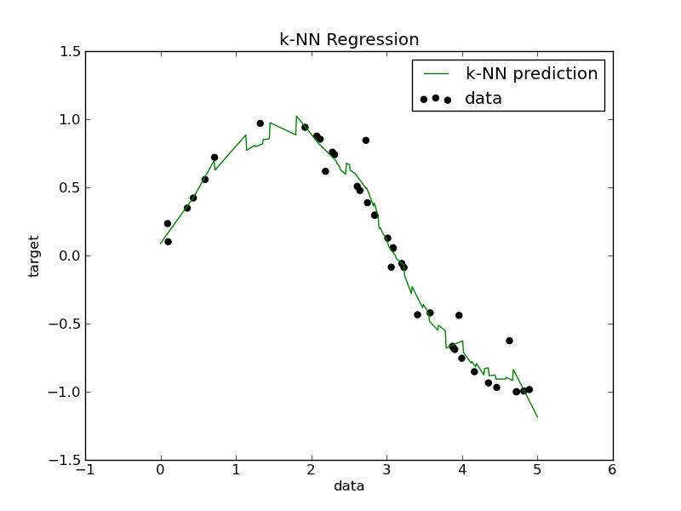
Nearest Neighbor Models (k-NN)
If the data is distributed linearly, it can be predicted using Linear Regression.
However, what if the data is non-linear, as shown below?
Let’s use k-NN!

Slide 20
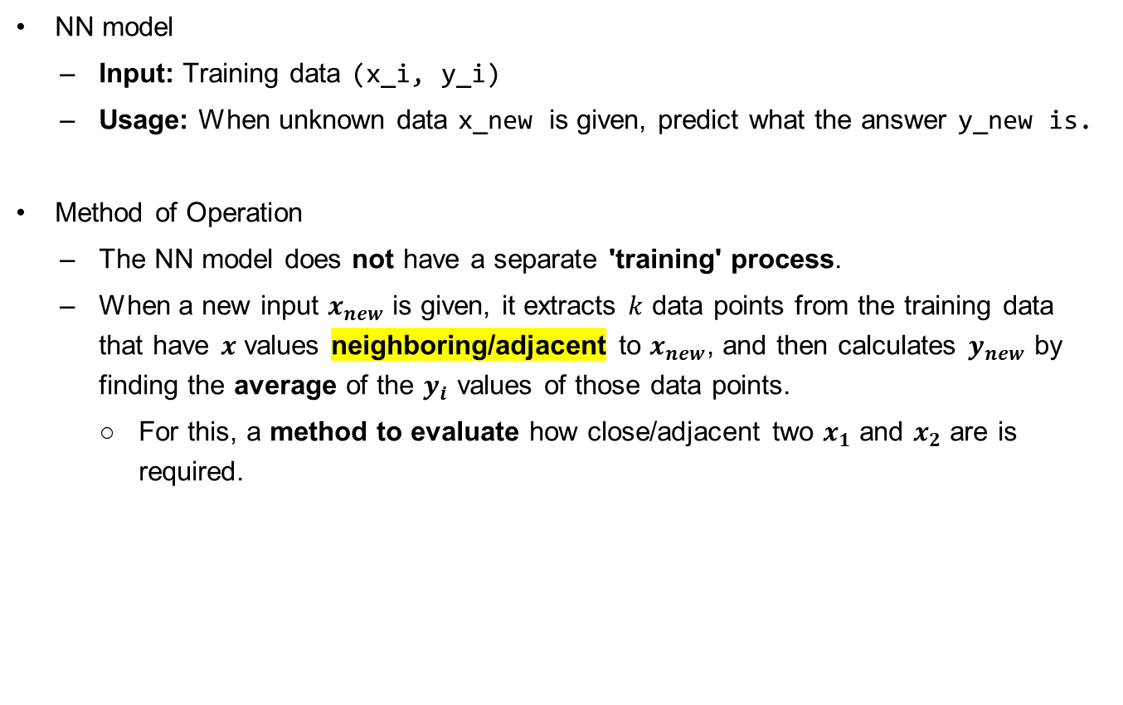
Nearest Neighbor Models (k-NN)
NN model
  Input: Training data (x_i, y_i)
  Usage: When unknown data x_new is given, predict what the answer y_new is.
Method of Operation
  The NN model does not have a separate 'training' process.
  When a new input $x_{new}$ is given, it extracts $k$ data points from the training data that have $x$ values neighboring/adjacent to $x_{new}$, and then calculates $y_{new}$ by finding the average of the $y_{i}$ values of those data points.
    For this, a method to evaluate how close/adjacent two $x_{1}$ and $x_{2}$ are is required.

Slide 21

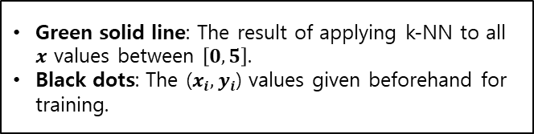
Nearest Neighbor Models (k-NN)
Given a query x_{q} (= Unknown input data), find the k nearest neighbors NN(k, x_{q})
  $NN\left(x_{q},k\right)$: Used by extracting a set of $k$ data points that are adjacent/neighboring to $x_{q}$ along the $x$-axis.
  Regression (Two methods for predicting $y_{new}$ using $k$ neighboring values):
    mean or median of NN(k, x_{q}) or // NN 집합 내의 y_i 값의 평균/중간값을 사용하거나
    solve a linear regression problem on NN(k, x_{q}) // NN 집합 내의 값에 LR 적용
Green solid line: The result of applying k-NN to all $x$ values between $\left[0,5\right]$.
Black dots: The ($x_{i},y_{i}$) values given beforehand for training.
The k-NN technique does not create a separate model or go through training, but it shows effective performance in predicting values.
Furthermore, it can handle non-linear data more effectively compared to linear regression.

Slide 22
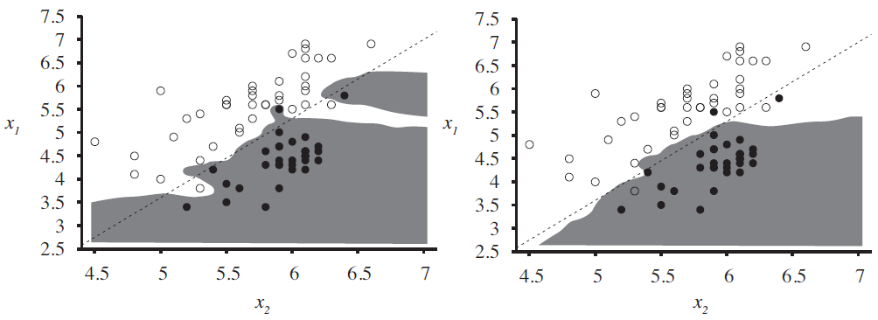
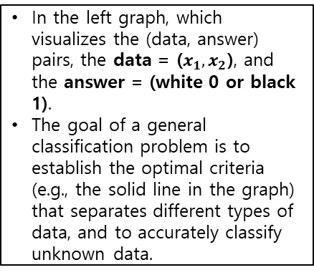
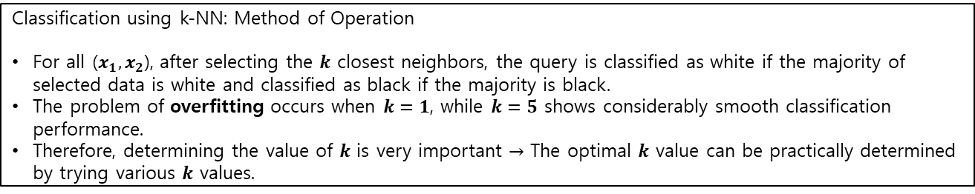
Nearest Neighbor Models (k-NN)
Given a query x_{q}, find the k nearest neighbors NN(k, x_{q})
  Furthermore, the k-NN technique can also be used for classification problems.
  Classification: plurality vote of NN(k, x_{q}) // Majority rule
  Overfitting with k = 1 O.K. with k = 5
In the left graph, which visualizes the (data, answer) pairs, the data = ($x_{1},x_{2}$), and the answer = (white 0 or black 1).
The goal of a general classification problem is to establish the optimal criteria (e.g., the solid line in the graph) that separates different types of data, and to accurately classify unknown data.
Classification using k-NN: Method of Operation
For all ($x_{1},x_{2}$), after selecting the $k$ closest neighbors, the query is classified as white if the majority of selected data is white and classified as black if the majority is black.
The problem of overfitting occurs when $k=1$, while $k=5$ shows considerably smooth classification performance.
Therefore, determining the value of $k$ is very important $→$ The optimal $k$ value can be practically determined by trying various $k$ values.

Slide 23
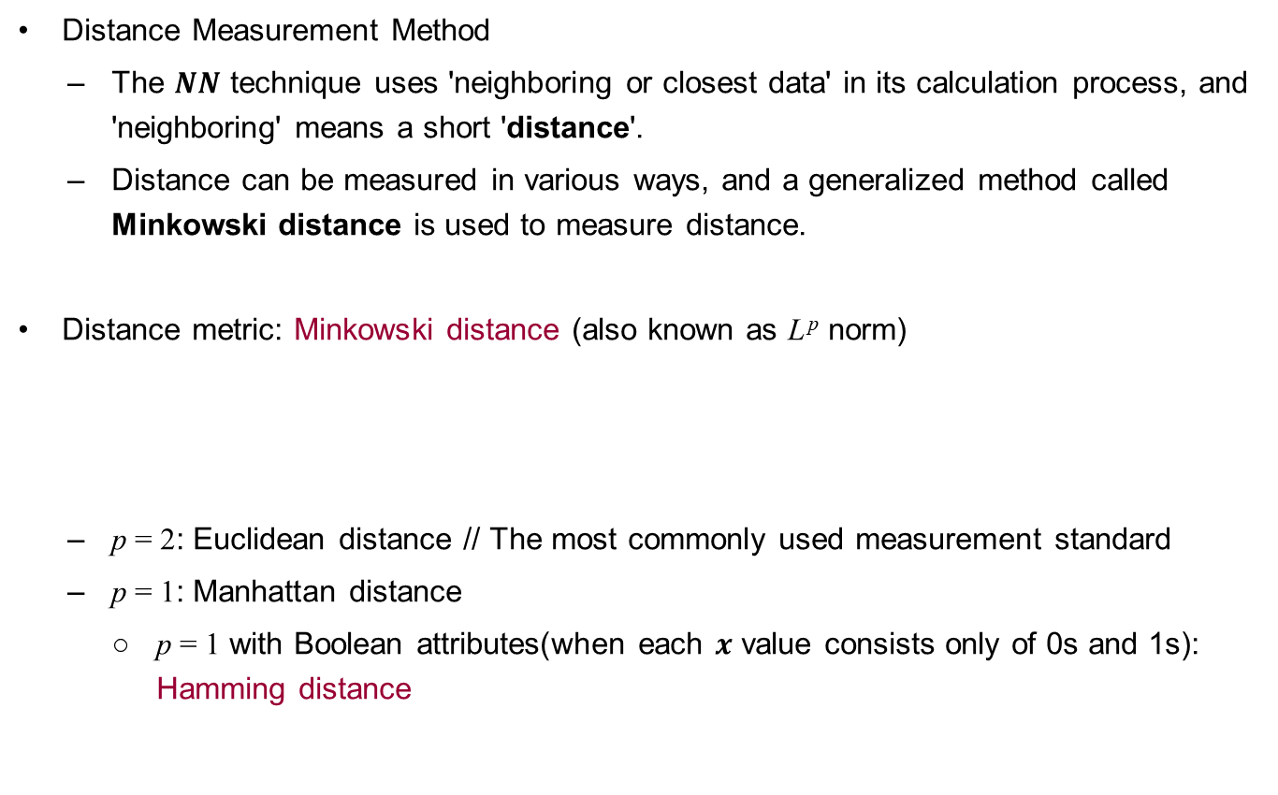
Nearest Neighbor Models (k-NN)
Distance Measurement Method
  The $NN$ technique uses 'neighboring or closest data' in its calculation process, and 'neighboring' means a short 'distance'.
  Distance can be measured in various ways, and a generalized method called Minkowski distance is used to measure distance.
Distance metric: Minkowski distance (also known as L ^{p} norm)
  p = 2: Euclidean distance // The most commonly used measurement standard
  p = 1: Manhattan distance
    p = 1 with Boolean attributes(when each $x$ value consists only of 0s and 1s): Hamming distance

Slide 24
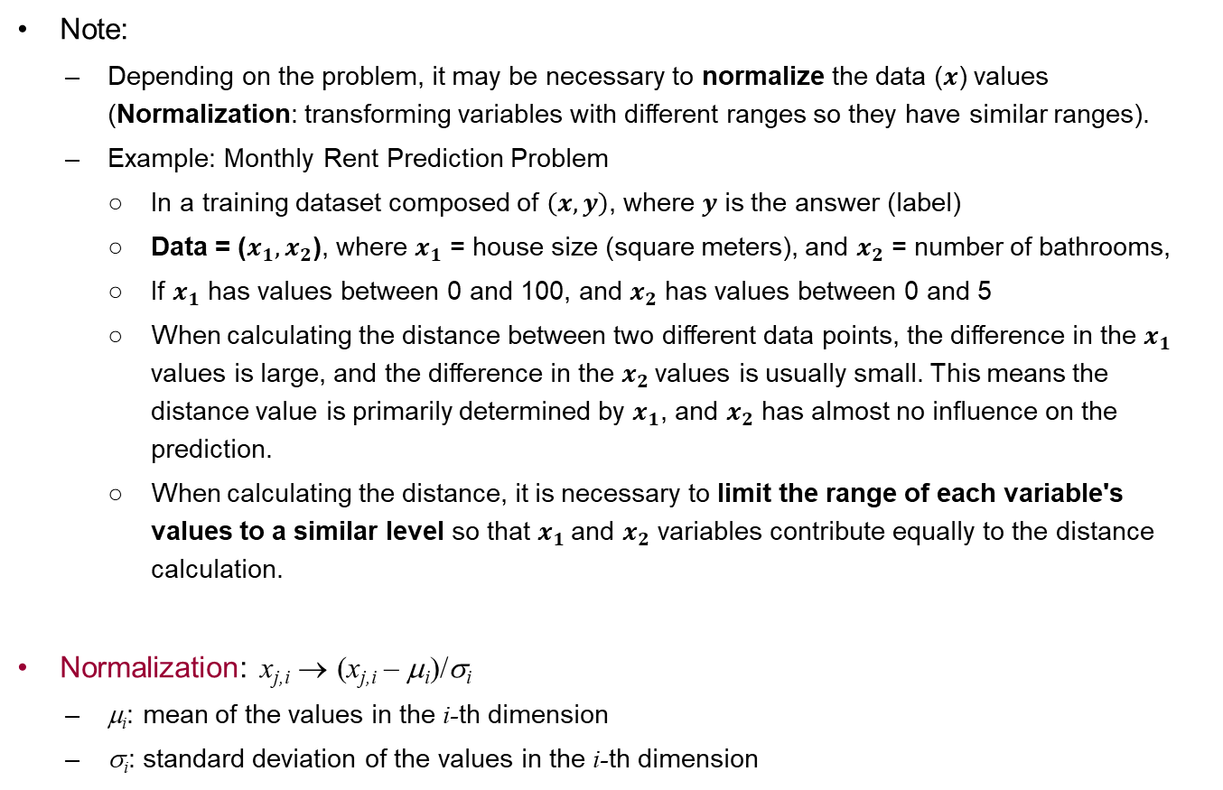
Nearest Neighbor Models (k-NN)
Note:
  Depending on the problem, it may be necessary to normalize the data ($x$) values (Normalization: transforming variables with different ranges so they have similar ranges).
  Example: Monthly Rent Prediction Problem
    In a training dataset composed of $\left(x,y\right)$, where $y$ is the answer (label)
    Data = ($x_{1},x_{2}$), where $x_{1}$ = house size (square meters), and $x_{2}$ = number of bathrooms,
    If $x_{1}$ has values between 0 and 100, and $x_{2}$ has values between 0 and 5
    When calculating the distance between two different data points, the difference in the $x_{1}$ values is large, and the difference in the $x_{2}$values is usually small. This means the distance value is primarily determined by $x_{1}$, and $x_{2}$ has almost no influence on the prediction.
    When calculating the distance, it is necessary to limit the range of each variable's values to a similar level so that $x_{1}$and $x_{2}$ variables contribute equally to the distance calculation.
Normalization: x_{j,i} → (x_{j,i} – μ_{i})/σ_{i}
  μ_{i}: mean of the values in the i-th dimension
  σ_{i}: standard deviation of the values in the i-th dimension

Slide 25
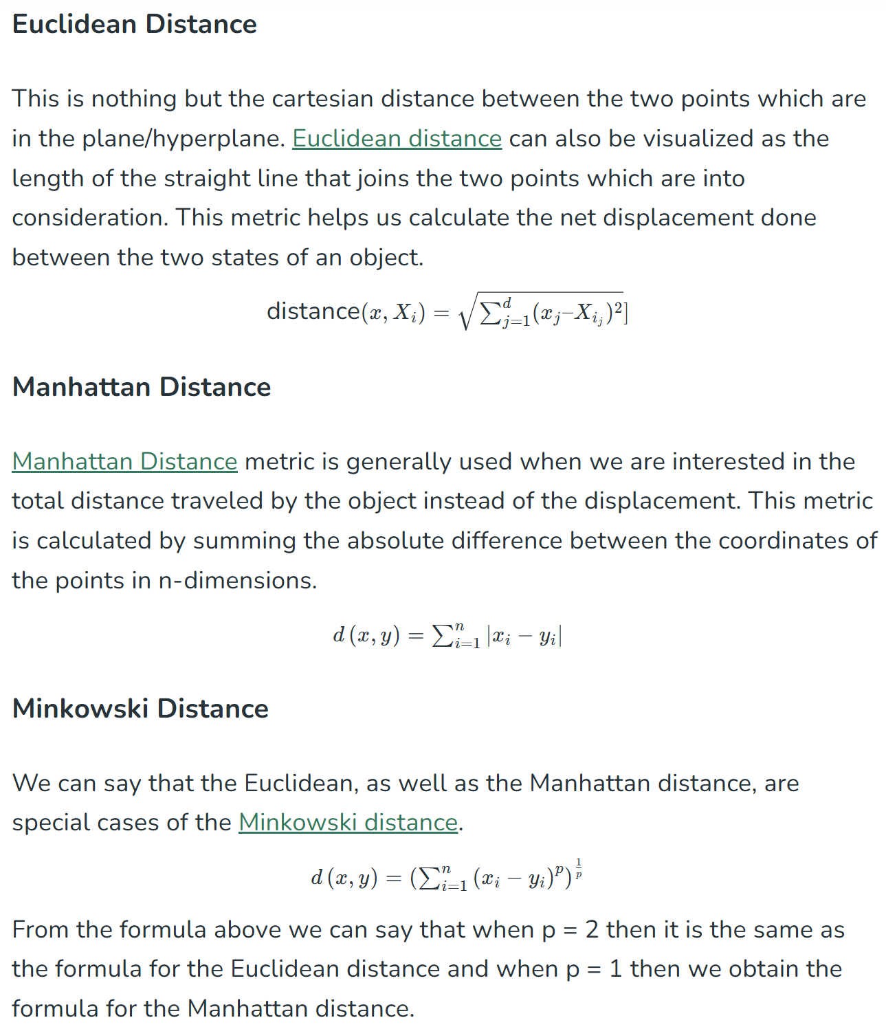
Nearest Neighbor Models (k-NN)
Various "distance"
calculation methods
https://www.geeksforgeeks.org/k-nearest-neighbours/

Slide 26
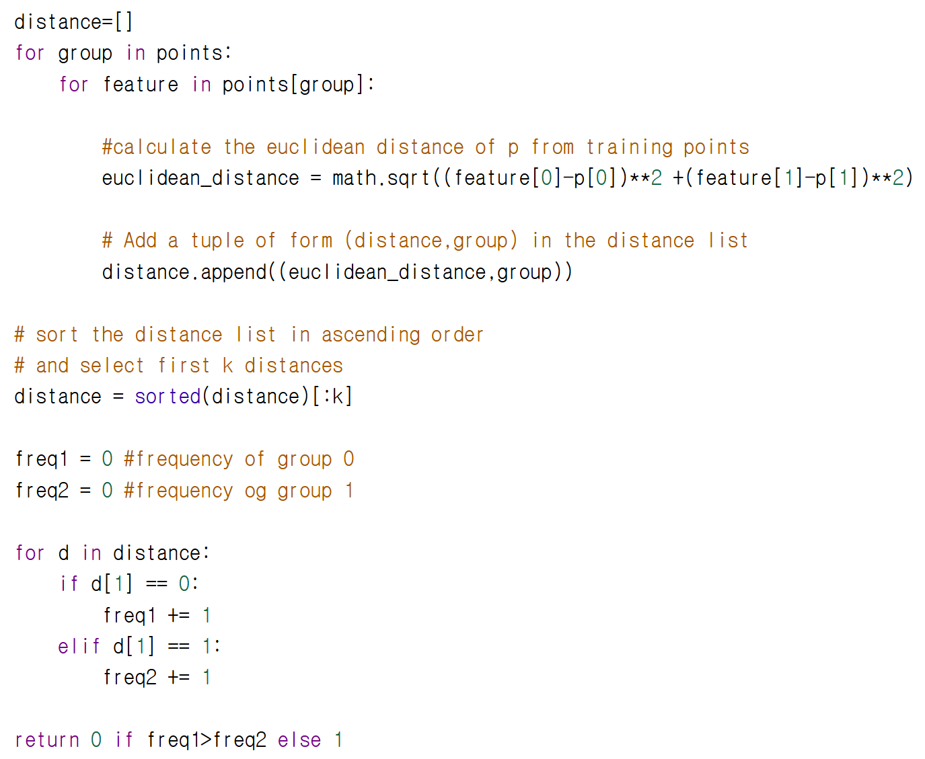



Nearest Neighbor Models (k-NN)
Example of KNN code for classifying the input value ($p$) into Group 0 or Group 1
Calculates the Euclidean distance between the input value (p) and all points in the dataset.
Extracts $k$ data points that have the minimum distance.
Counts the number of data points included in Group 0 and the number of data points included in Group 1 among the $k$ data points.
https://www.geeksforgeeks.org/k-nearest-neighbours/

Slide 27
End

